Slide 1


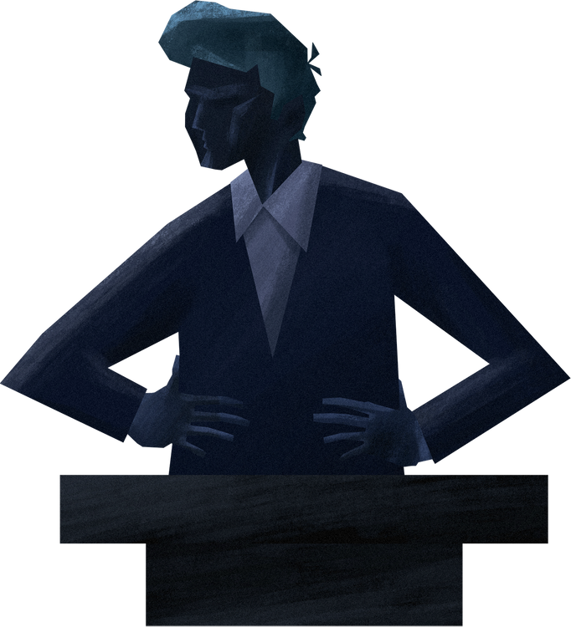



Reading And Writing Skills 11
CLAIMS OF FACT, VALUE, AND POLICY

Slide 2

WHAT IS A CLAIM?
A claim is a statement that a writer explores, explains, or proves in an argument. A claim should place an argument in the context of a larger debate that probably involves addressing potential objections or counterarguments.

Slide 3


WHAT IS A CLAIM?
Making your claims fit to your argument makes your convincing power unbeatable because an intelligent claim makes an intelligent communication.

Slide 4

THREE KINDS OF CLAIMS
CLAIM OF FACT
CLAIM OF VALUE
CLAIM OF POLICY

Slide 5
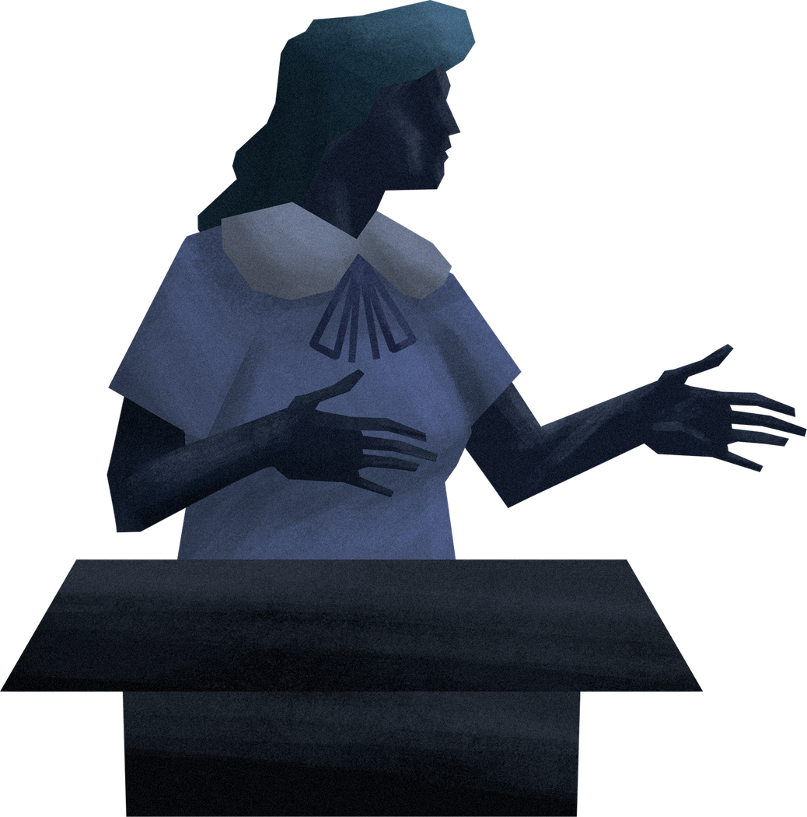
CLAIM OF FACT
A Claim of Fact asserts that something quantifiable has existed, does exist, or will exist. The center of controversy in a factual claim is over the reasonableness of the fact in question.
Claims of fact may be assertions about the past, present, or future.
A type of claim that affirms or asserts whether a statement is true or untrue.

Slide 6




EXAMPLES
Social distancing is important during the coronavirus pandemic.
The Philippine Eagle is a critically endangered species.
Video games lead to an increase in violence and addiction among teens.

Slide 7
CLAIM OF VALUE
A Claim of Value asserts qualitative judgments along a good-to-bad continuum relating to persons, events, and things in one’s environment.
A type of claim that evaluates, appraises, or judges an idea.
Can state whether the author thinks the idea is good or bad, right or wrong, ethical or unethical, or just or unjust. May be influenced by the author’s religious, cultural, and social values.

Slide 8



EXAMPLES
Going to the beach is the best way to spend your vacation.
Filipino food is the best food of all time.
Experimenting with drag is the best way I’ve found to explore my feelings about masculinity and femininity.

Slide 9

CLAIM OF POLICY
A Claim of Policy asserts that something should or should not be done by someone about something. It proposes that some specific course of action should, but not necessarily will, be taken.
Makes use of words such as should, ought to, and must.
May argue against an already established policy or solution.

Slide 10



EXAMPLES
Students should read the assigned text material before the instructor lectures on it.
Marijuana should not be legalized in our country because many individuals will abuse it.
The government must create an effective plan to address the traffic.

Slide 11




CHARACTERISTICS OF A GOOD CLAIM
A claim should be argumentative and debatable.
A claim should be specific and and focused.
A claim should be engaging and interesting.
A claim should be logical.

Slide 12



REMEMBER
Claims of fact are quantifiable statements that focus on the accuracy, correctness or validity of such statements and can be verified using some objective evidence.
Claims of value are qualitative statements that focus on judgments made about the environment and invite comparisons.
Claims of policy are statements that focus on actions that should be taken to change the status quo.

Slide 13
GROUP ACTIVITY
Instruction: The teacher will divide the class into four groups. Each group needs one representative to choose between the four envelopes. Based on the topic and the image provided, each group will be given 2 minutes to write their sentences according to the types of claims they will pick.

Slide 14
SEATWORK NO. 1
Instruction: Identify whether the statement is a claim of fact, value, or policy. Write COF if it’s a claim of fact, COV if it's a claim of value, and COP if it's a claim of policy. Write your answer in the space provided.

Slide 15
ASSIGNMENT NO. 1
MAKE A CLAIM: Read the provided article below. Formulate a claim of fact, value, and policy based on the article about mental health.
Mental Health
Everyone feels worried, anxious, or down from time to time. But relatively few people develop a mental illness. What's the difference? A mental illness is a mental health condition that gets in the way of thinking, relating to others, and day-to-day functions.
Dozens of mental illnesses have been identified and defined. They include depression, generalized anxiety disorder, bipolar disorder, obsessive-compulsive disorder, post-traumatic stress disorder, schizophrenia, and many more.
Mental illness is an equal opportunity issue. It affects young and old, male and female, and individuals of every race, ethnic background, education level, and income level. The good news is that it can often be treated.

Slide 16
ASSIGNMENT NO. 1
Signs and symptoms of mental illness depend in part on the illness. Common symptoms include
feeling down for a while
extreme swings in mood
withdrawing from family, friends, or activities
low energy or problems sleeping
often feeling angry, hostile, or violent
feeling paranoid, hearing voices, or having hallucinations
often thinking about death or suicide.
In some people, symptoms of a mental illness first appear as physical problems such as stomach aches, back pain, or insomnia. Individuals with a mental illness can often ease their symptoms and feel better by talking with a therapist and following a treatment plan that may or may not include medication.

Slide 17
ASSIGNMENT NO. 1
https://www.health.harvard.edu/topics/mental-health?fbclid=IwZXh0bgNhZW0CMTAAAR15-rrKgIbLE_jHGjPFiT-EM2OyoMxwTRu20Sf_AdHqAfWZa9KYdrlQNnY_aem_AcRuHpzH91iSByCMFurXPQXuhd2i0oSq3_PrCvxrYURfXuMSbAfuiZfbGJ-N02TI3srjVcUJJnJovRrhg52IwU4Q

Slide 18
THANK YOU FOR LISTENING

